Slide 1

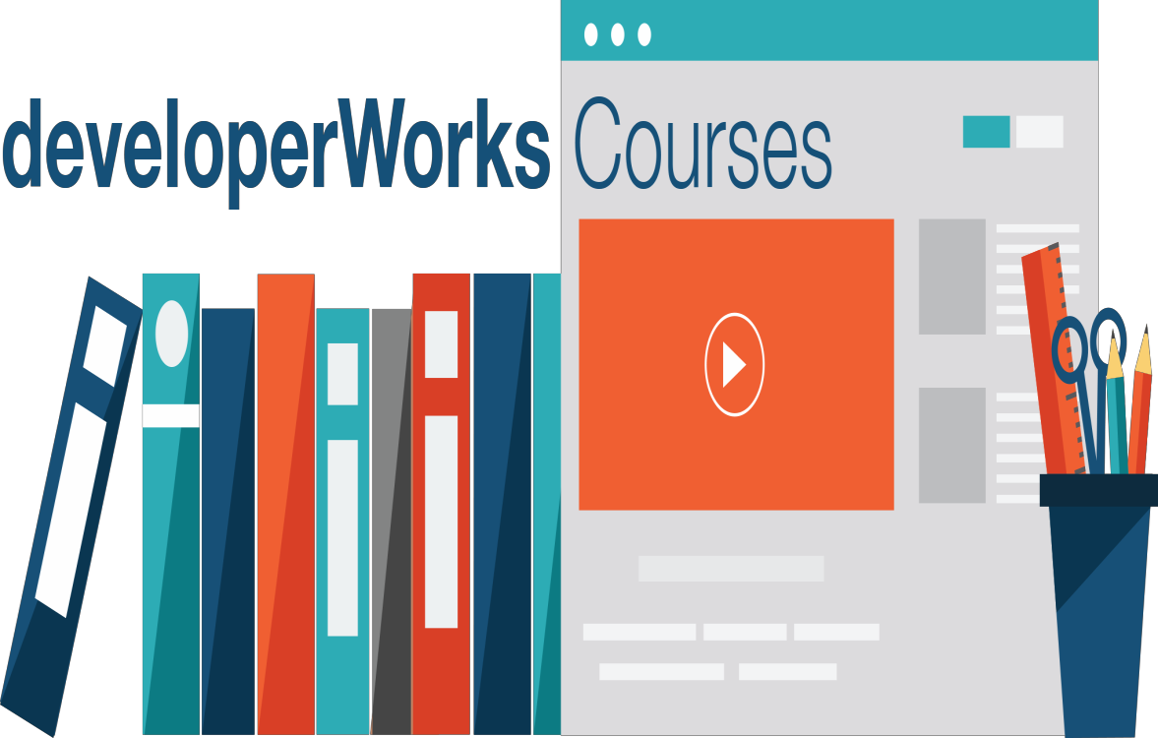
Application Deployment in Bluemix
Cloud Developer Certification Preparation

Slide 2
After you complete this unit, you should understand:
The lifecycle of an IBM Bluemix PaaS application:
  Pushing, deploying, and managing the application
  How applications are processed in a Bluemix virtual machines (VM) and containers
  How the application is invoked by end users

Slide 3
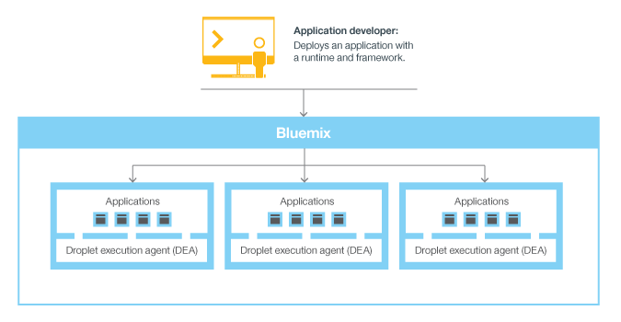
Bluemix application lifecycle
Upload application components and metadata.
Create and bind services.
Stage the application.
Deploy the application.
Manage the health of the application.

Slide 4
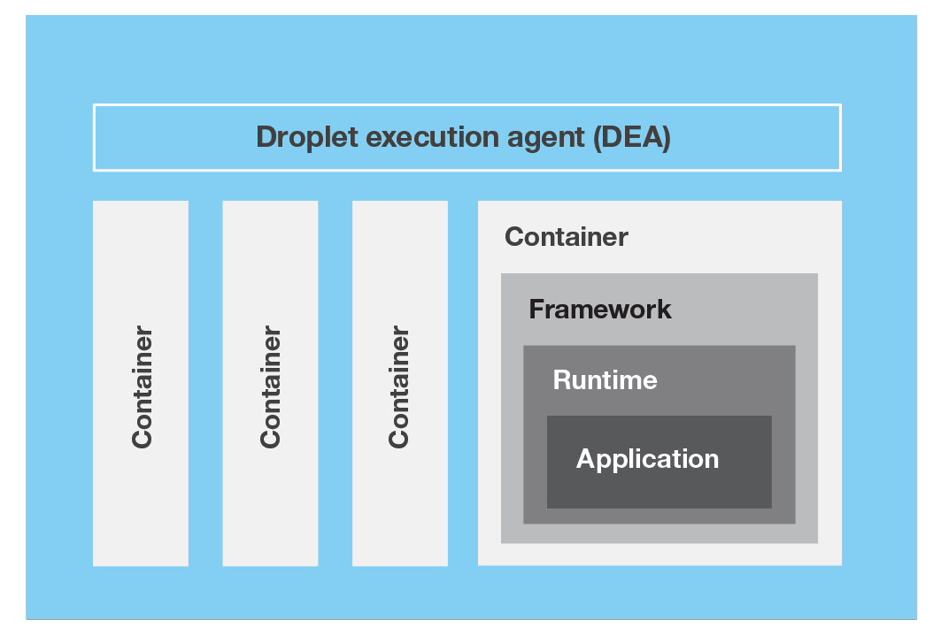
Components of a VM

Slide 5
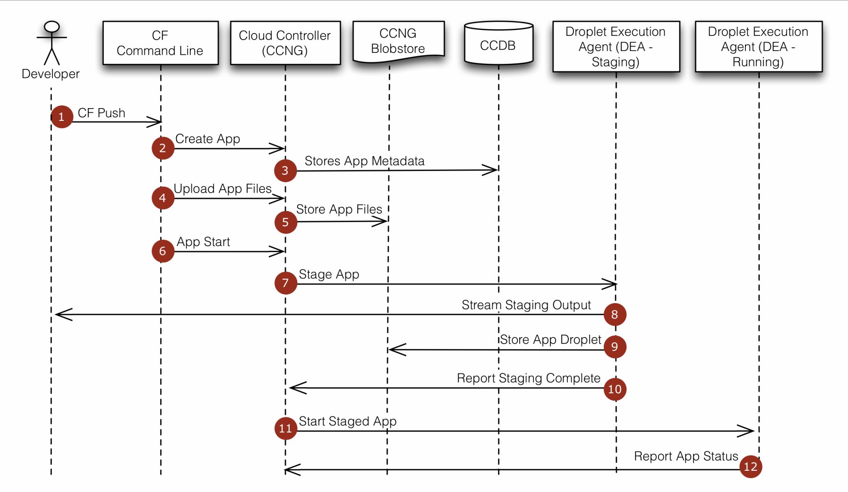
Application staging and deployment

Slide 6
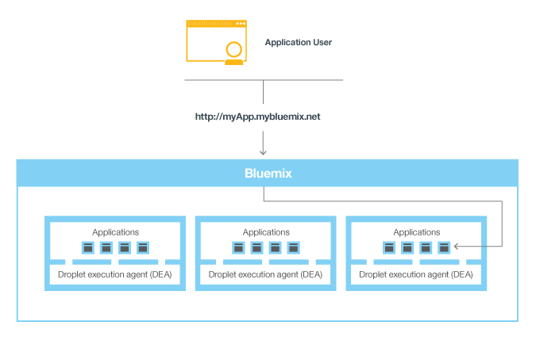
Invoking a Bluemix application
6

